Slide 1
Cisco Certified Network Associate
(CCNA)

Slide 2
Module-4-B Routing

Slide 3
Dynamic Routing Protocols

Slide 4
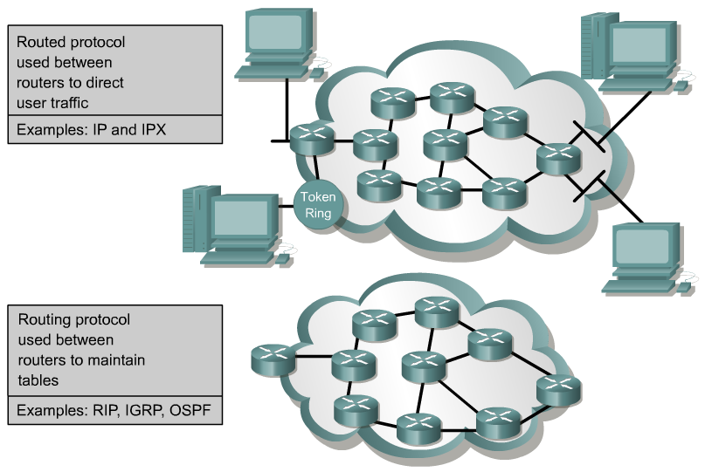
Routed Protocols vs. Routing Protocols

Slide 5
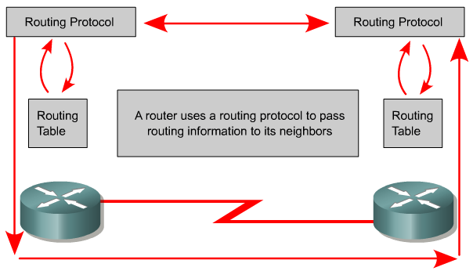
Routing Protocols
The goal of a routing protocol is to build and maintain the routing table.
This table contains the learned networks and associated ports for those networks.
Routers use routing protocols to manage information received from other routers, information learned from the configuration of its own interfaces, along with manually configured routes.

Slide 6
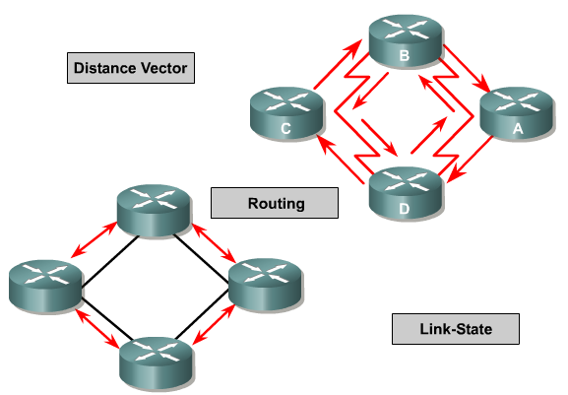
Types of Routing Protocols
Distance Vector: RIP, IGRP, EIGRP
Link State: OSPF, IS-IS
Path Vector: BGP
Note: IGRP and EIGRP are Cisco Proprietary

Slide 7
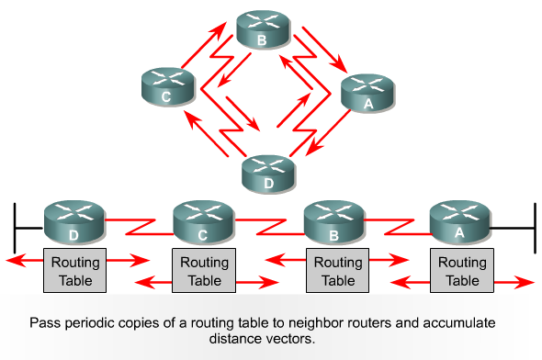
Distance Vector Routing Protocols
Router B receives information from Router A.
Router B adds a distance vector number (such as a number of hops), which increases the distance vector.
Then Router B passes this new routing table to its other neighbor, Router C.
This same step-by-step process occurs in all directions between neighbor routers.
“Routing by rumor”
Each router receives a routing table from its directly connected neighbor routers.

Slide 8
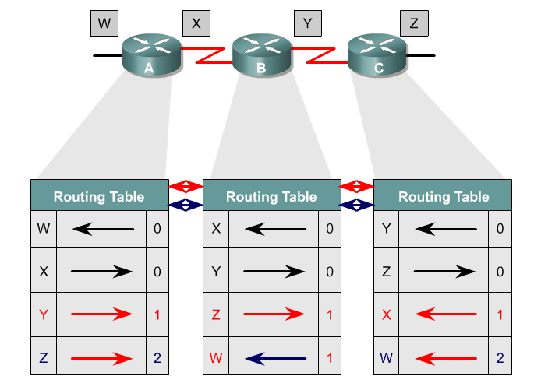
Distance Vector Routing Protocols

Slide 9
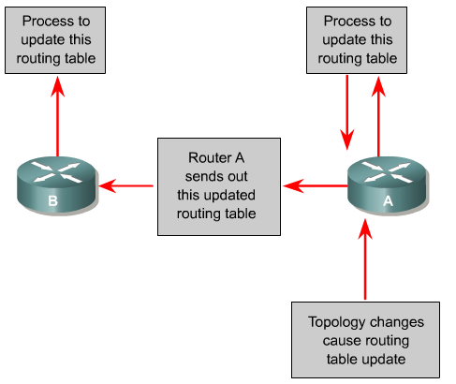
Distance Vector Routing Protocols
Routing table updates occur when the topology changes. As with the network discovery process, topology change updates proceed step-by-step from router to router.
With some routing protocols routing tables updates happen on a periodic basis.

Slide 10
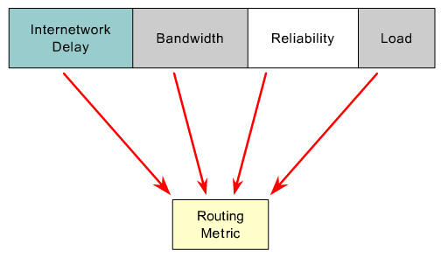
Routing Protocol Metrics
RIP – Hop Count
IGRP and EIGRP – Bandwidth, Delay, Reliability, Load
OSPF – Bandwidth
IS-IS – Cost
BGP – Number of AS or policy

Slide 11
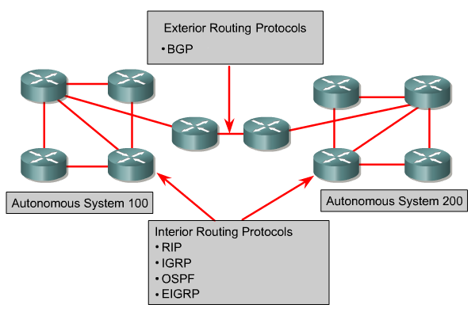
Routing Protocols
RIP – A distance vector interior routing protocol
IGRP – Cisco's distance vector interior routing protocol
OSPF – A link-state interior routing protocol
EIGRP – Cisco’s advanced distance vector interior routing protocol
BGP – A distance vector exterior routing protocol

Slide 12
Routing Information Protocols
Routing Information Protocol (RIP)
It is a distance vector routing protocol.
Hop count is used as the metric for path selection.
If the hop count is greater than 15, the packet is discarded.
Routing updates are broadcast every 30 seconds, by default.
RIP : RIP only uses hop count and is capable of performing round-robin load balancing to up to six equal-cost links.
Pinhole congestion happens when two equal-cost links are of different bandwidth, which is disregarded by RIP. Routing information messages including the complete routing table are sent every 30 sec by default.

Slide 13
Routing Information Protocols
Routing loops: is due to the slow convergence of RIP and occurs when conflicting update information is received from different routers.
Maximum Hop Count: will set any network beyond a certain distance to be unreachable with the max hop count +1. 15+1
Split Horizon: enforces the rule that information cannot be sent back in the direction from which it was received.
Route Poisoning: sets down links to the unreachable value. It is followed by a poison reverse.
Hold-downs: timer that prevents conflicting rapid updates of the routing tables. Once a value is changed, the router will wait the hold-down timer prior accepting another change.
Triggered Updates: resets the hold-down timer if the timer expires, the router receives a processing task proportional to the number of links or another update is received indicating the network topology has changed. Creates a new routing table sent immediately to neighbour routers.

Slide 14
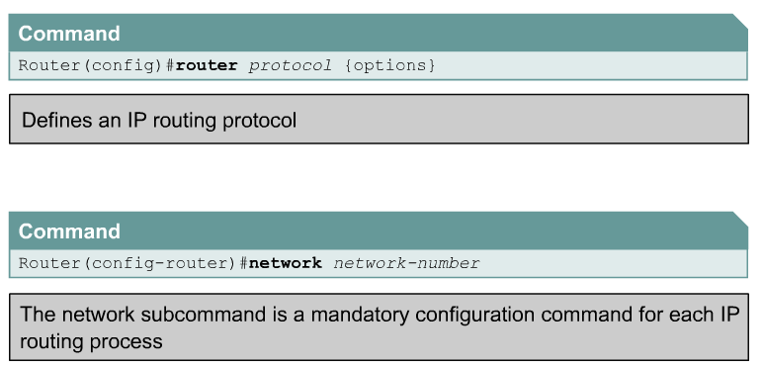
Configuring RIP
GAD(config)#router rip
GAD(config-router)#network 172.16.0.0
(config-router)#passive-interface type number
the interface will not send RIP messages but still receive them

Slide 15
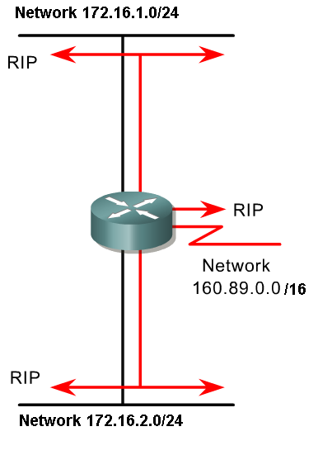
Network command two things:
Tells the router which interfaces that will participate in this dynamic routing protocol, which interfaces it will send and receive routing updates on.
Tells other routers the networks in its routing updates that it is directly connect to.

Slide 16
Interior Gateway Routing Protocol
Interior Gateway Routing Protocol (IGRP) is a proprietary protocol developed by Cisco.
It is a distance vector routing protocol.
Bandwidth, load, delay and reliability are used to create a composite metric.
Routing updates are broadcast every 90 seconds, by default.
IGRP Uses bandwidth, and delay as default metrics, and can also use reliability, load and Maximum Transmission Unit (MTU).

Slide 17
VERIFYING IGRP
# sh ip route: shows the routing tables. Also shows the administrative distance of each link, the hop count, the next hop and exit interface.
# sh [ip] protocols: network layer address of each interface or (with ip) the routing protocols on the router and timers used.
# debug ip rip/(igrp events/transactions): rip and igrp transactions send routing updates to the console. igrp events only sends a summary, including the destination and provenance, and the number of routers included in each message.
# undebug all: turns off debugging. show debug will show what debug options are turned on.
# ping address: verify connectivity with remote host.

Slide 18
IGRP Configuration
(config)#router igrp ASnumber: enables IGRP, but only shares information between the routers on the same autonomous system (AS).
(config-router)#network network: limits the propagation of the RIP messages to the network.

Slide 19
Lab works on RIP & IGRP

Slide 20
EIGRP

Slide 21
Objectives
EIGRP concepts
EIGRP configuration
Troubleshooting Routing protocols

Slide 22
Comparing EIGRP with IGRP
Comparisons between EIGRP and IGRP fall into the following major categories:
  Compatibility mode
  Metric calculation
  Hop count
  Automatic protocol redistribution
  Route tagging

Slide 23
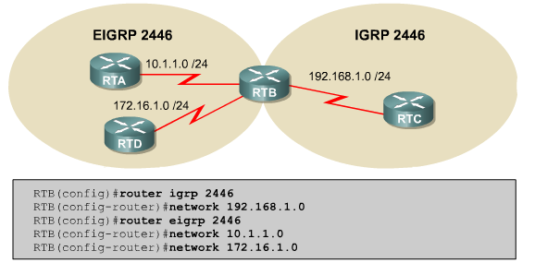
Using EIGRP with IGRP

Slide 24
EIGRP Concepts
Every EIGRP router maintains a topology table for each configured network protocol.
All learned routes to a destination are maintained in the topology table.

Slide 25
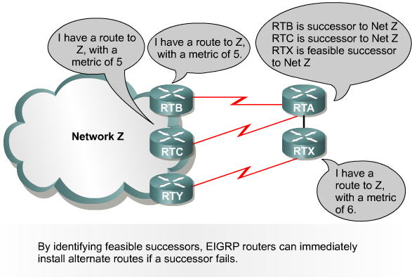
EIGRP Successors and Feasible Successors

Slide 26
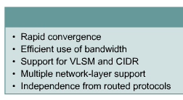
EIGRP Design Features

Slide 27
EIGRP Technologies
Neighbor discovery and recovery
Reliable Transport Protocol
DUAL finite-state machine algorithm
Protocol-dependent modules
By forming adjacencies, EIGRP routers:
  Dynamically learn of new routes that join their network
  Identify routers that become either unreachable or inoperable
  Rediscover routers that had previously been unreachable

Slide 28
Data Structure
The five EIGRP packet types are as follows:
    Hello (used to discover, verify, and rediscover neighbor routers)
    Acknowledgment
    Update
    Query
    Reply

Slide 29
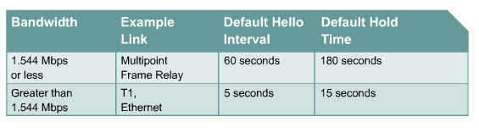
Default Hello Intervals and Hold Times for EIGRP

Slide 30
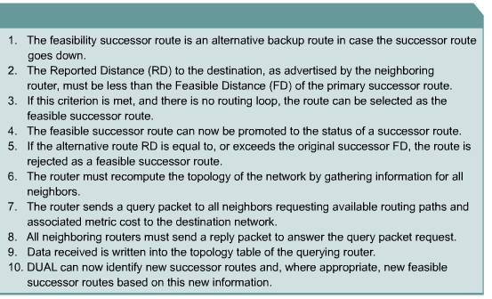
Feasible Successor Route Selection Rules

Slide 31
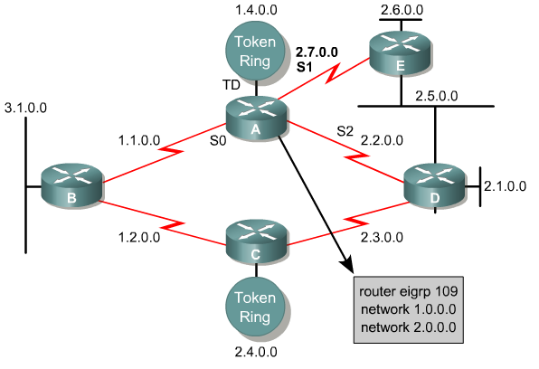
Configuring EIGRP

Slide 32
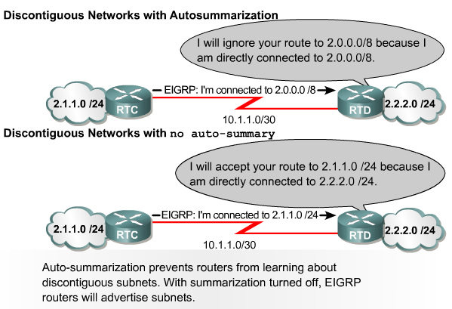
EIGRP Automatically Summarizes Based on Class

Slide 33
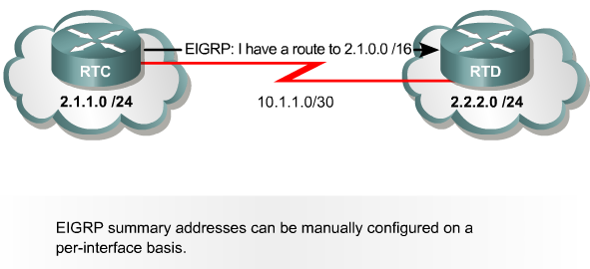
Manual Summarization with EIGRP

Slide 34
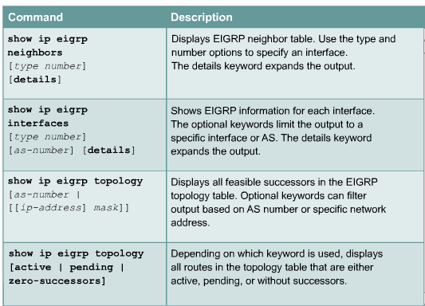
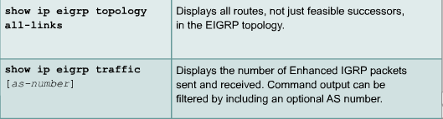
Verifying EIGRP

Slide 35
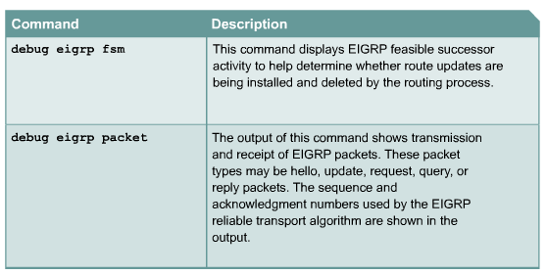
EIGRP debug Commands

Slide 36
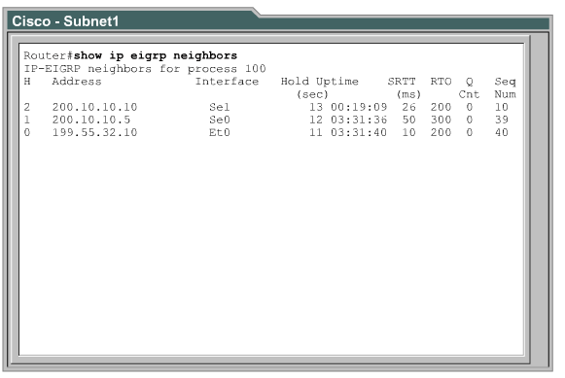
Building Neighbor Tables

Slide 37
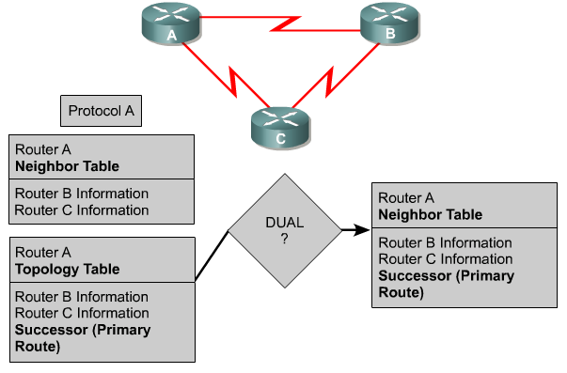
Discover Routes

Slide 38
Select Routes
If a link goes down, DUAL looks for an alternative route path, or feasible successor, in the topology table.
If a feasible successor is not found, the route is flagged as Active, or unusable at present.
Query packets are sent to neighboring routers requesting topology information.
DUAL uses this information to recalculate successor and feasible successor routes to the destination.

Slide 39
Troubleshooting Process
Analyze the network failure, make a clear problem statement.
Gather the facts needed to help isolate possible causes.
Consider possible problems based on the facts that have been gathered.
Create an action plan based on the remaining potential problems.
Implement the action plan, performing each step carefully while testing to see whether the symptom disappears.
Analyze the results to determine whether the problem has been resolved. If it has, the process is complete.
If the problem has not been resolved, create an action plan based on the next most likely problem in the list. Return to Step 4, change one variable at a time, and repeat the process until the problem is solved.
Once the actual cause of the problem is identified, try to solve it.

Slide 40
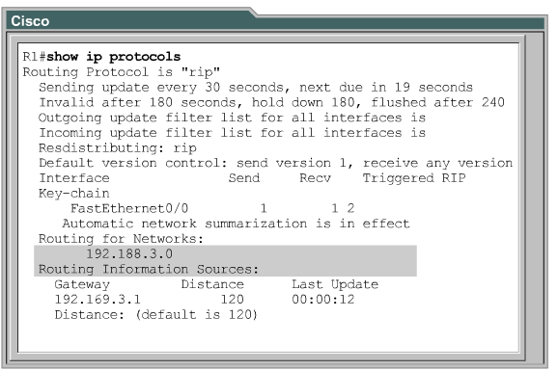
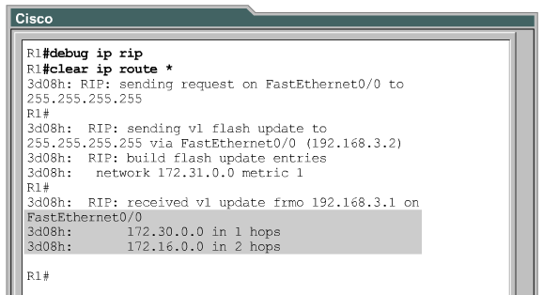
Troubleshooting RIP Configuration
Layer 1 or Layer 2 connectivity issues exist.
VLSM subnetting is configured. VLSM subnetting cannot be used with RIPv1
Mismatched RIPv1 and RIPv2 routing configurations exist.
Network statements are missing or incorrectly assigned.
The outgoing interface is down.
The advertised network interface is down.

Slide 41
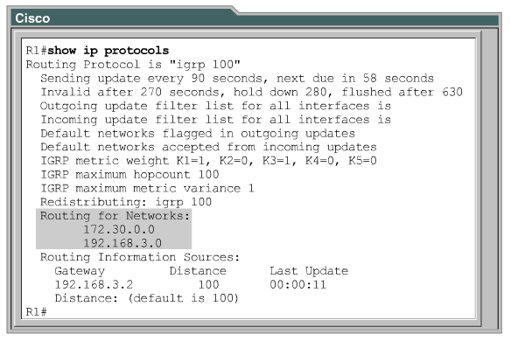
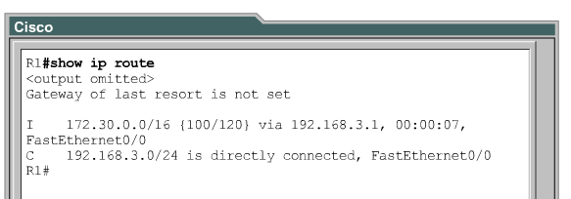
Troubleshooting IGRP Configuration

Slide 42
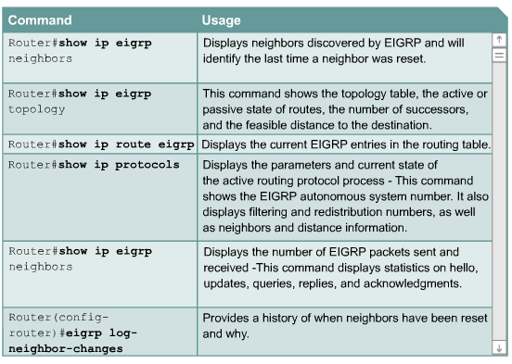
Troubleshooting EIGRP Configuration

Slide 43
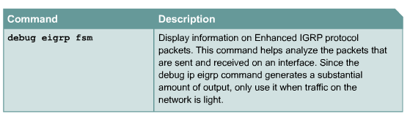
Troubleshooting EIGRP Configuration

Slide 44
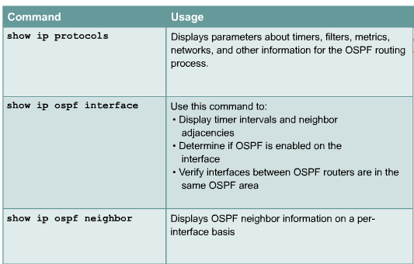
Troubleshooting OSPF Configuration

Slide 45
Lab on EIGRP

Slide 46
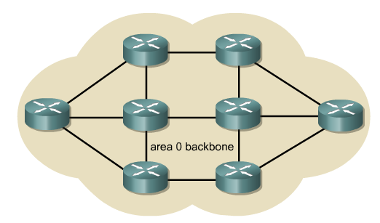
OSPF

Slide 47
Objectives
Link-state routing protocol
Single-area OSPF concepts
Single-area OSPF configuration

Slide 48
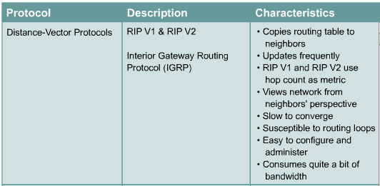
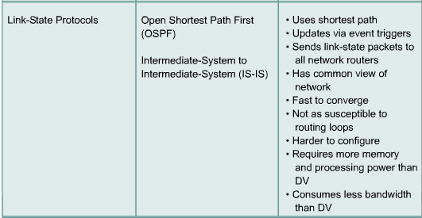
Overview of Link-State and Distance Vector Routing

Slide 49
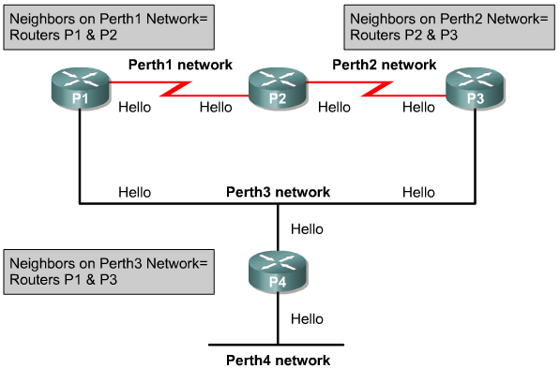
Link-State Routing Features

Slide 50
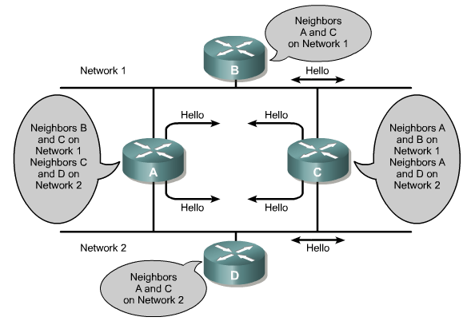
How Routing Information Is Maintained

Slide 51
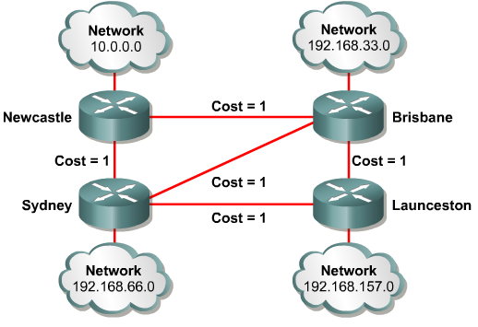
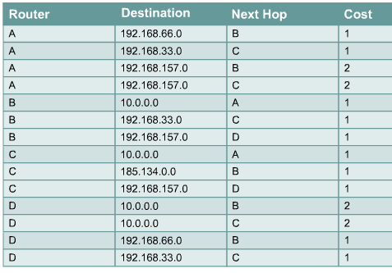
Link-State Routing Protocol Algorithms

Slide 52
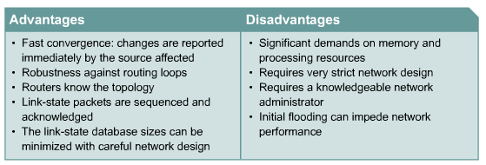
Advantages and Disadvantages of Link-State Routing

Slide 53
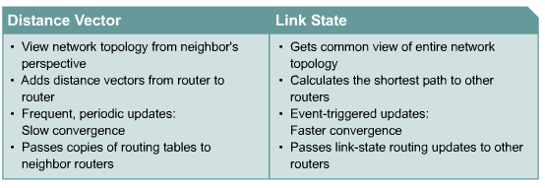
Comparing Distance Vector and Link-State Routing

Slide 54
OSPF Overview
OSPF is becoming the preferred IGP protocol when compared with RIPv1 and RIPv2 because it is scalable.

Slide 55
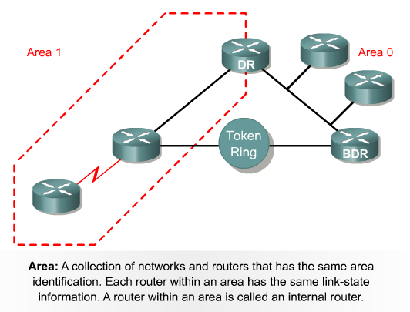
OSPF Terminology

Slide 56
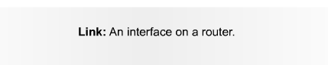
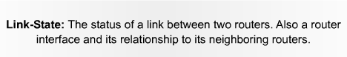
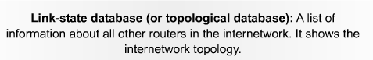




More OSPF Terminology

Slide 57
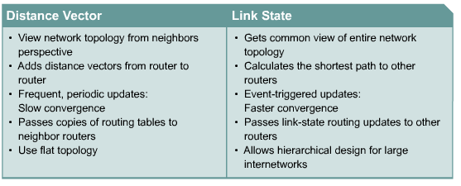
Comparing OSPF Link State with Distance Vector Routing Protocols

Slide 58
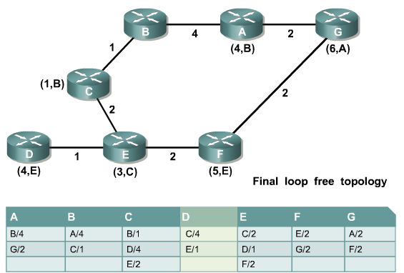
Shortest Path Algorithm
The best path is the lowest-cost path.

Slide 59
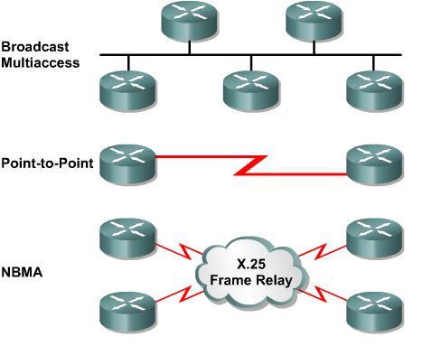
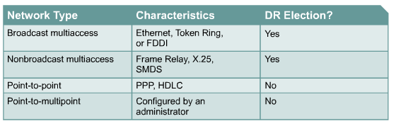
OSPF Network Types

Slide 60
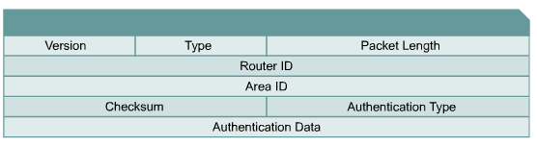
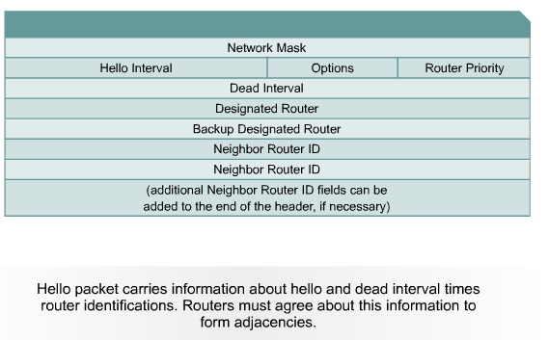
OSPF Hello Protocol

Slide 61
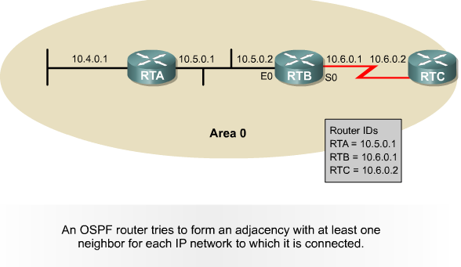
Steps in the Operation of OSPF
Discover neighbors

Slide 62

Steps in the Operation of OSPF
Elect DR and BDR on Multi Access Network

Slide 63

Steps in the Operation of OSPF
Selecting the Best Route

Slide 64

Basic OSPF Configuration

Slide 65

Basic OSPF Configuration

Slide 66

Configuring OSPF Loopback Address and Router Priority

Slide 67

Setting OSPF Priority
The priorities can be set to any value from 0 to 255. A value of 0 prevents that router from being elected. A router with the highest OSPF priority will win the election for DR.

Slide 68


Modifying OSPF Cost Metric

Slide 69

Configuring OSPF Authentication

Slide 70

Configuring OSPF Timers

Slide 71

OSPF - Propagating a Default Route

Slide 72

Common OSPF Configuration Issues

Slide 73
Verifying OSPF Configuration
show ip protocol
show ip route
show ip ospf interface
shop ip ospf
show ip ospf neighbor detail
show ip ospf database

Slide 74

The debug and clear Commands for OSPF Verification

